Slide 1

Photonics-Empowered Computing
— From Efficient to Functional Data Movement
Yuyang Wang
Postdoctoral Research Scientist, Columbia Nano Initiative
Columbia University in the City of New York, New York, NY 10027
🖂 yw3831@columbia.edu
January 15, 2025

Slide 2
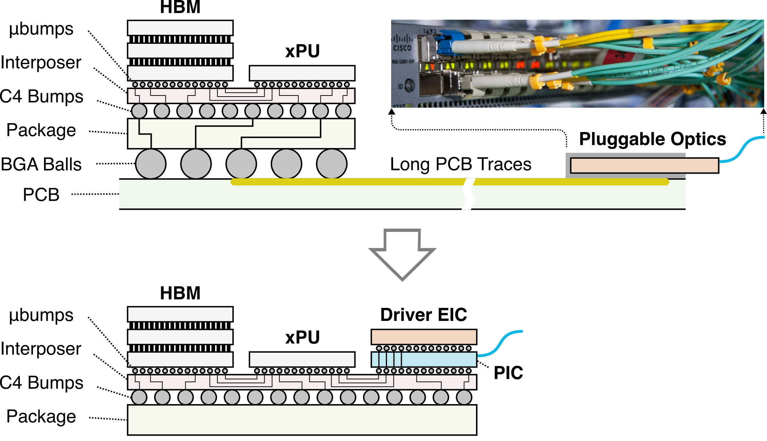
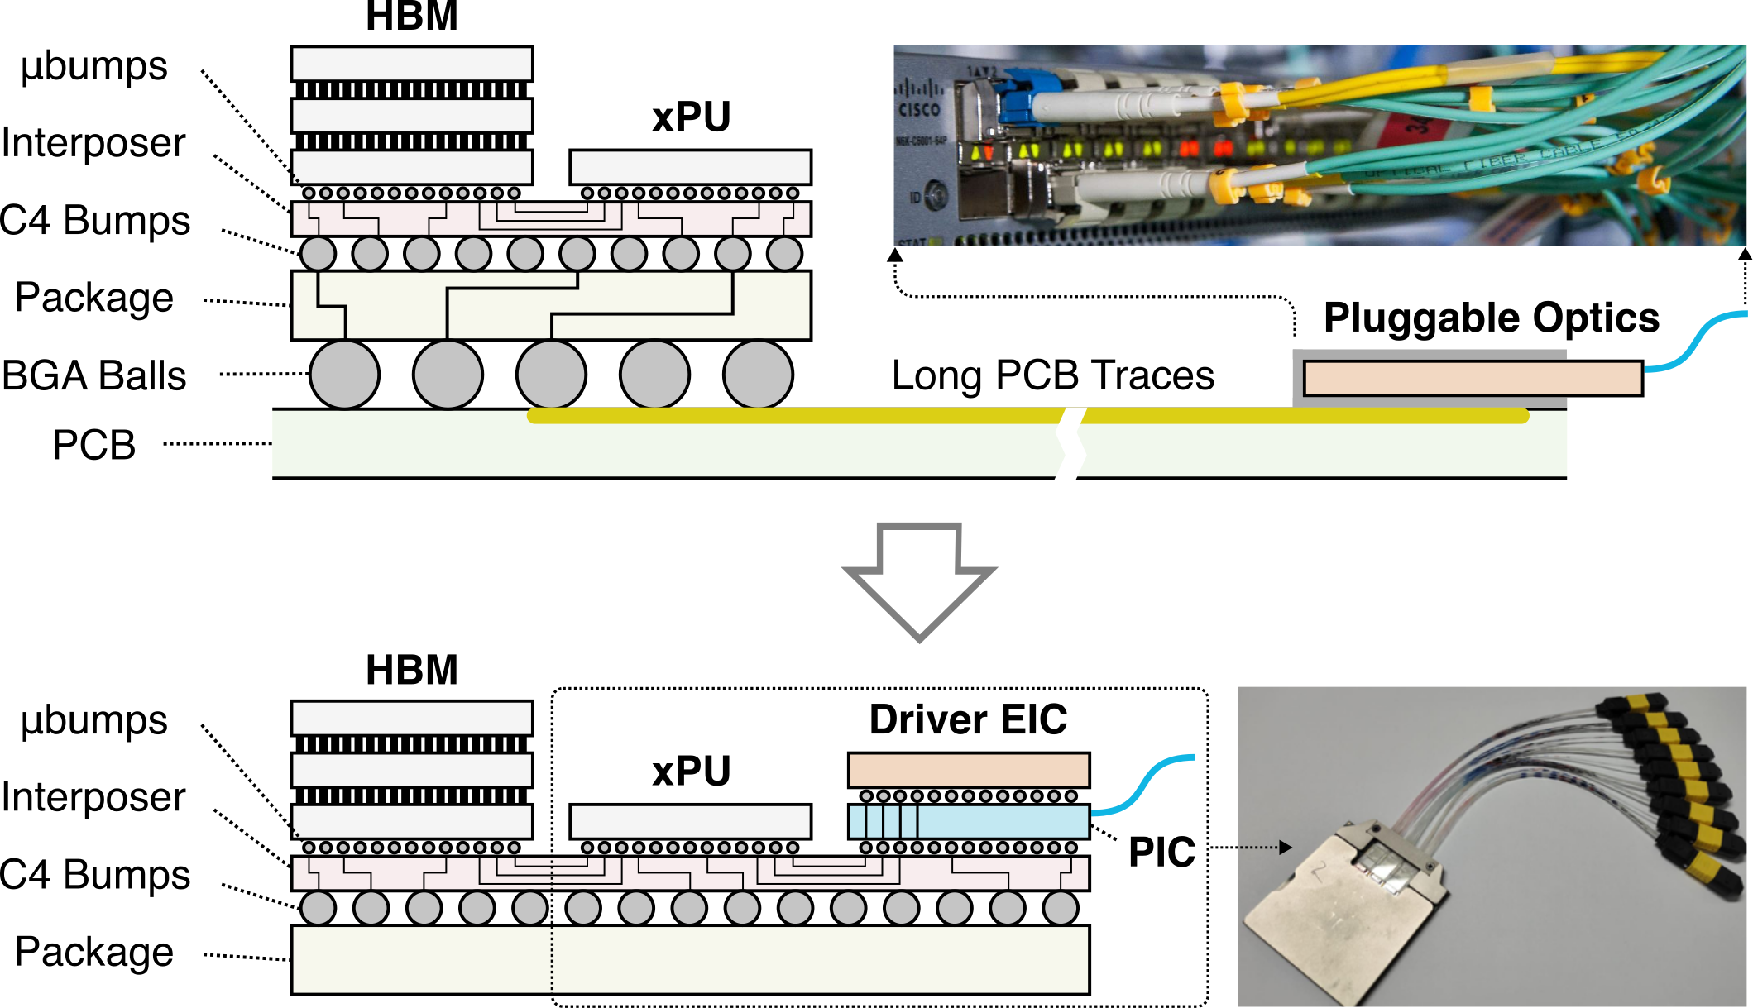
Bringing Photonics into Computing Sockets
Today’s optical connectivity:
My research:

Slide 3
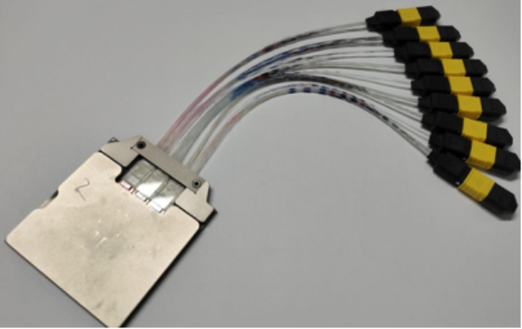
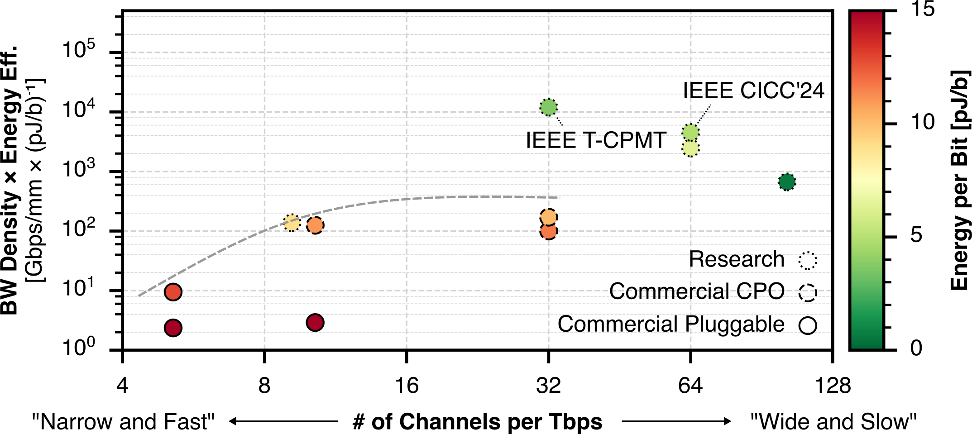
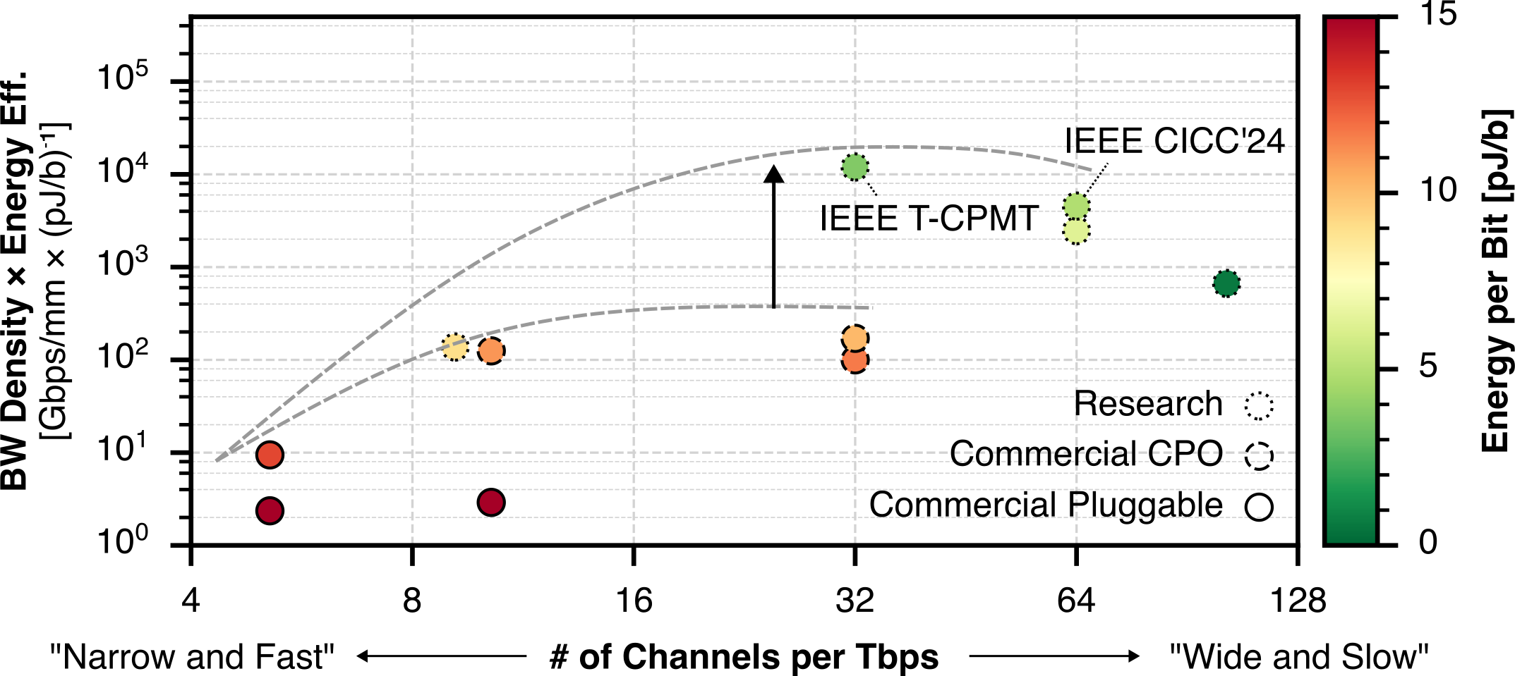
High-Bandwidth Density Energy-Efficient Data I/O
100x
Prior work
96 Tb/s bidirectional
4 Tb/s/mm shoreline
< 1 pJ/b energy

Slide 4
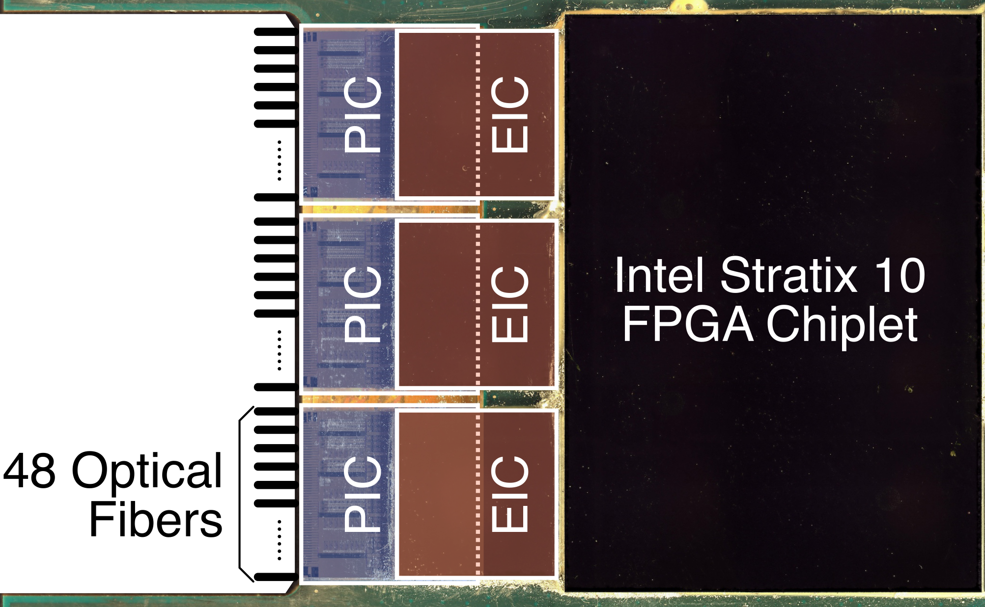
Hybrid 2.5D/3D Integration
PIC: My work
EIC: Cornell
Package: Intel

Slide 5
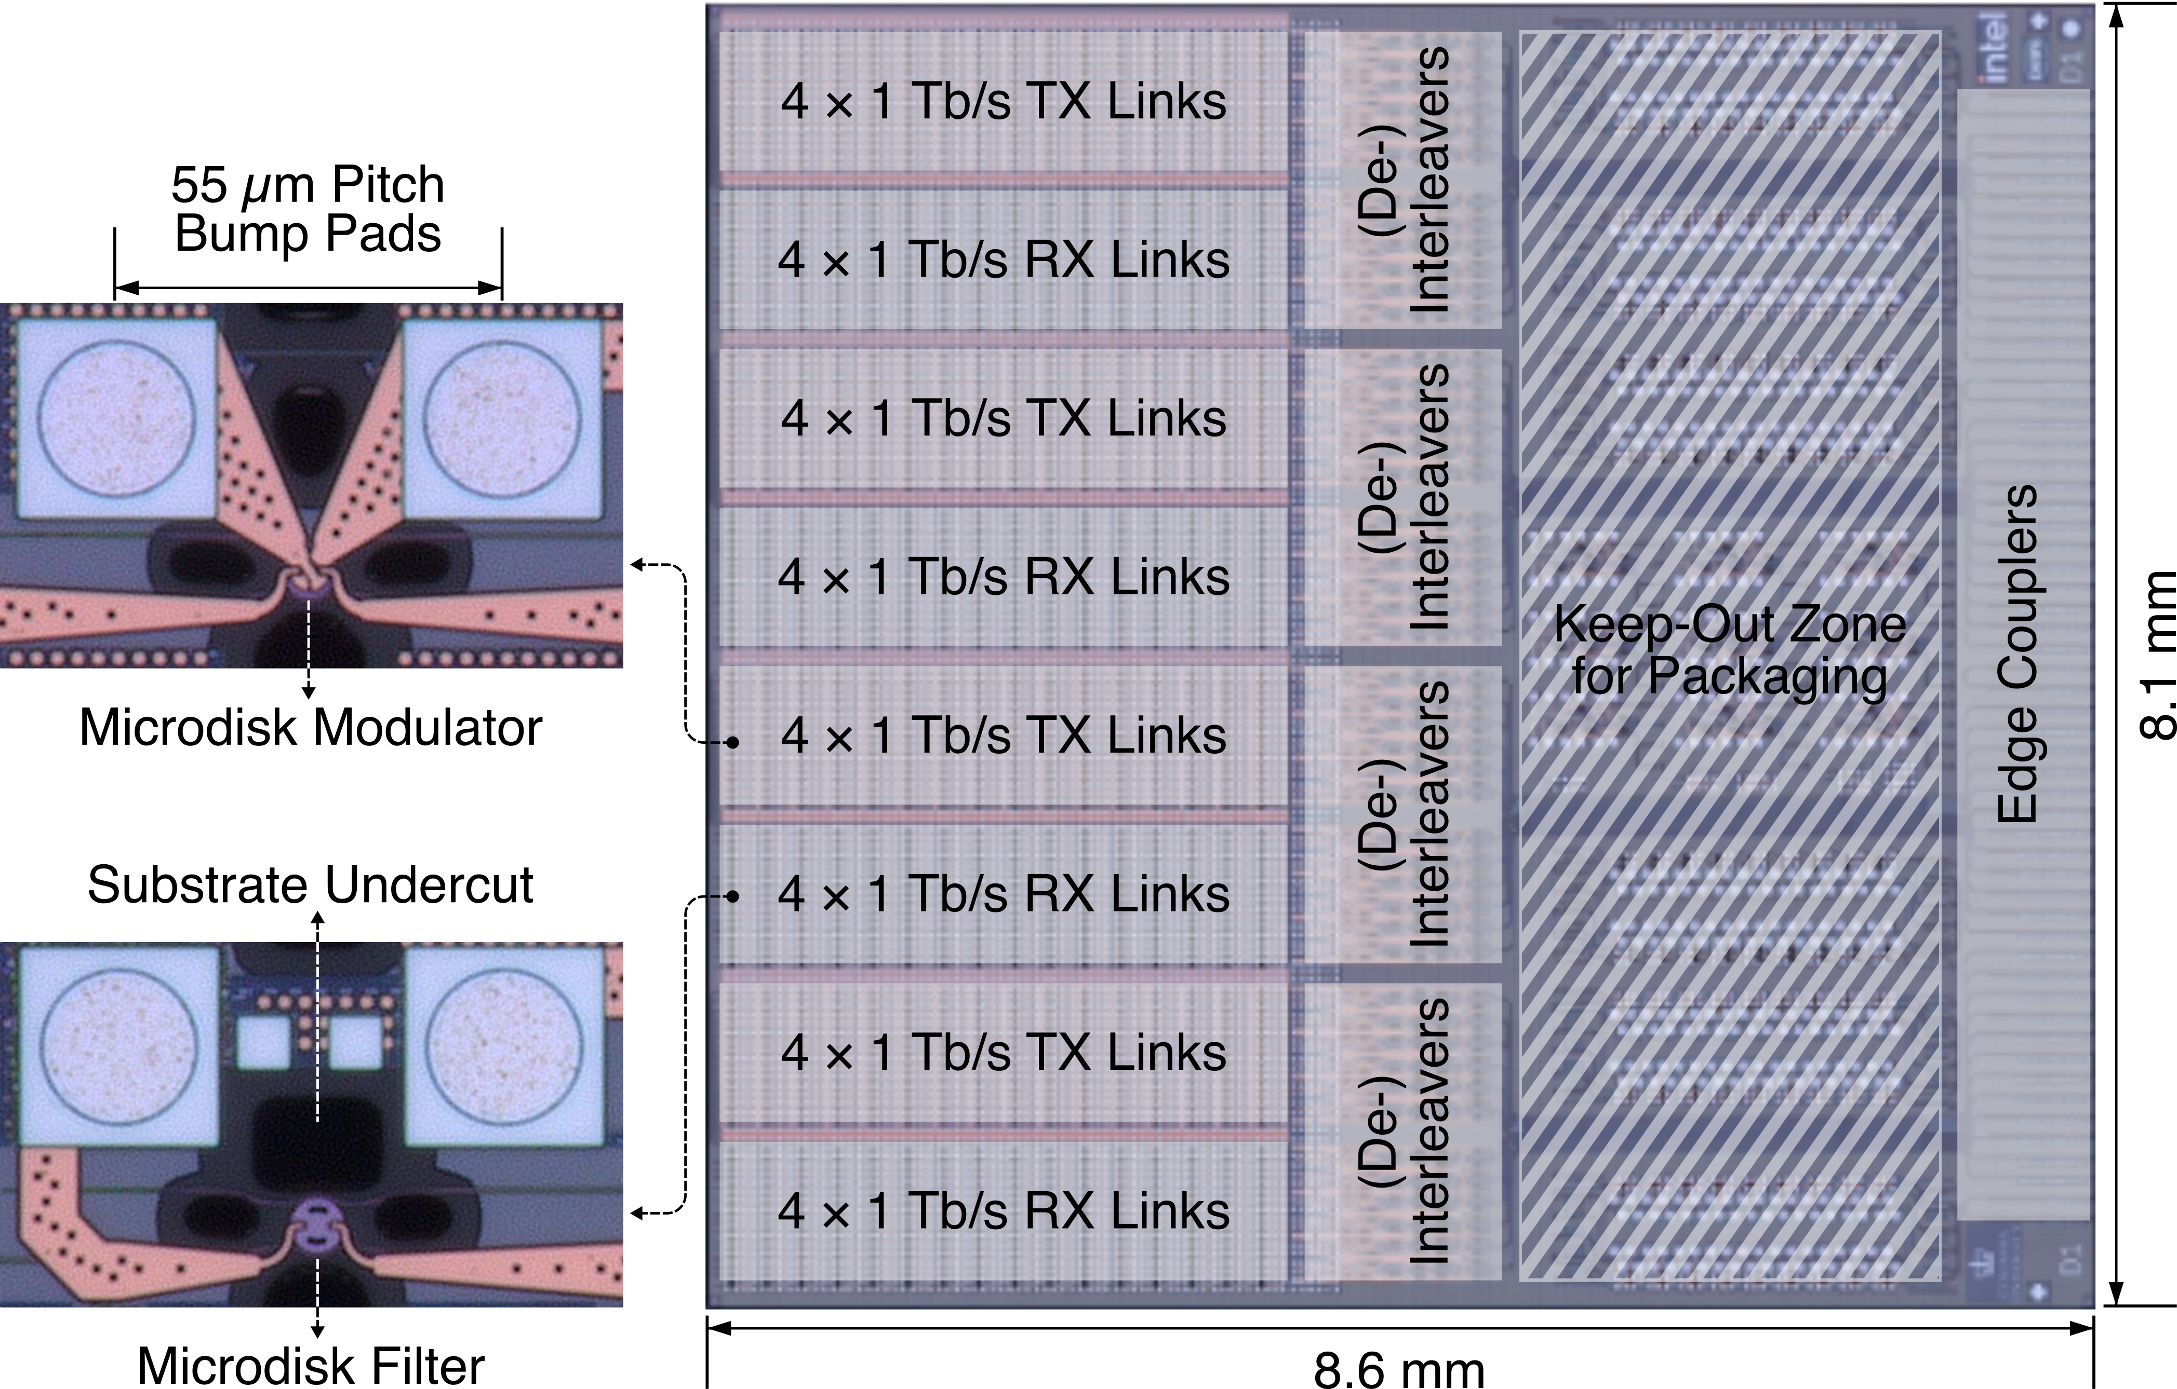
Photonic Chip Design for Packaging

Slide 6
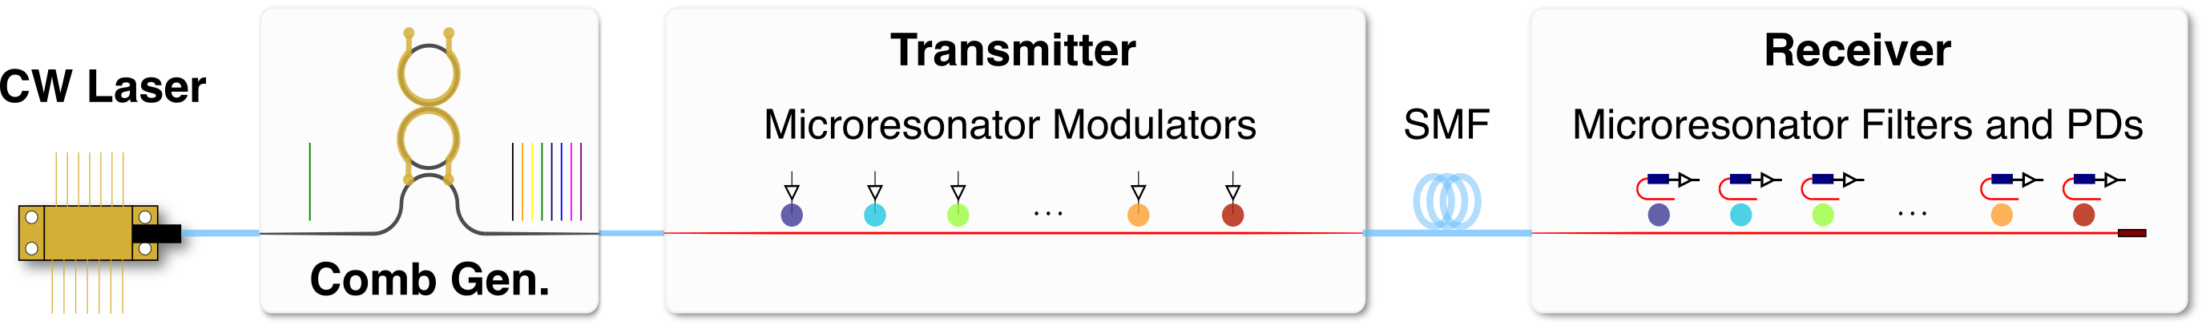
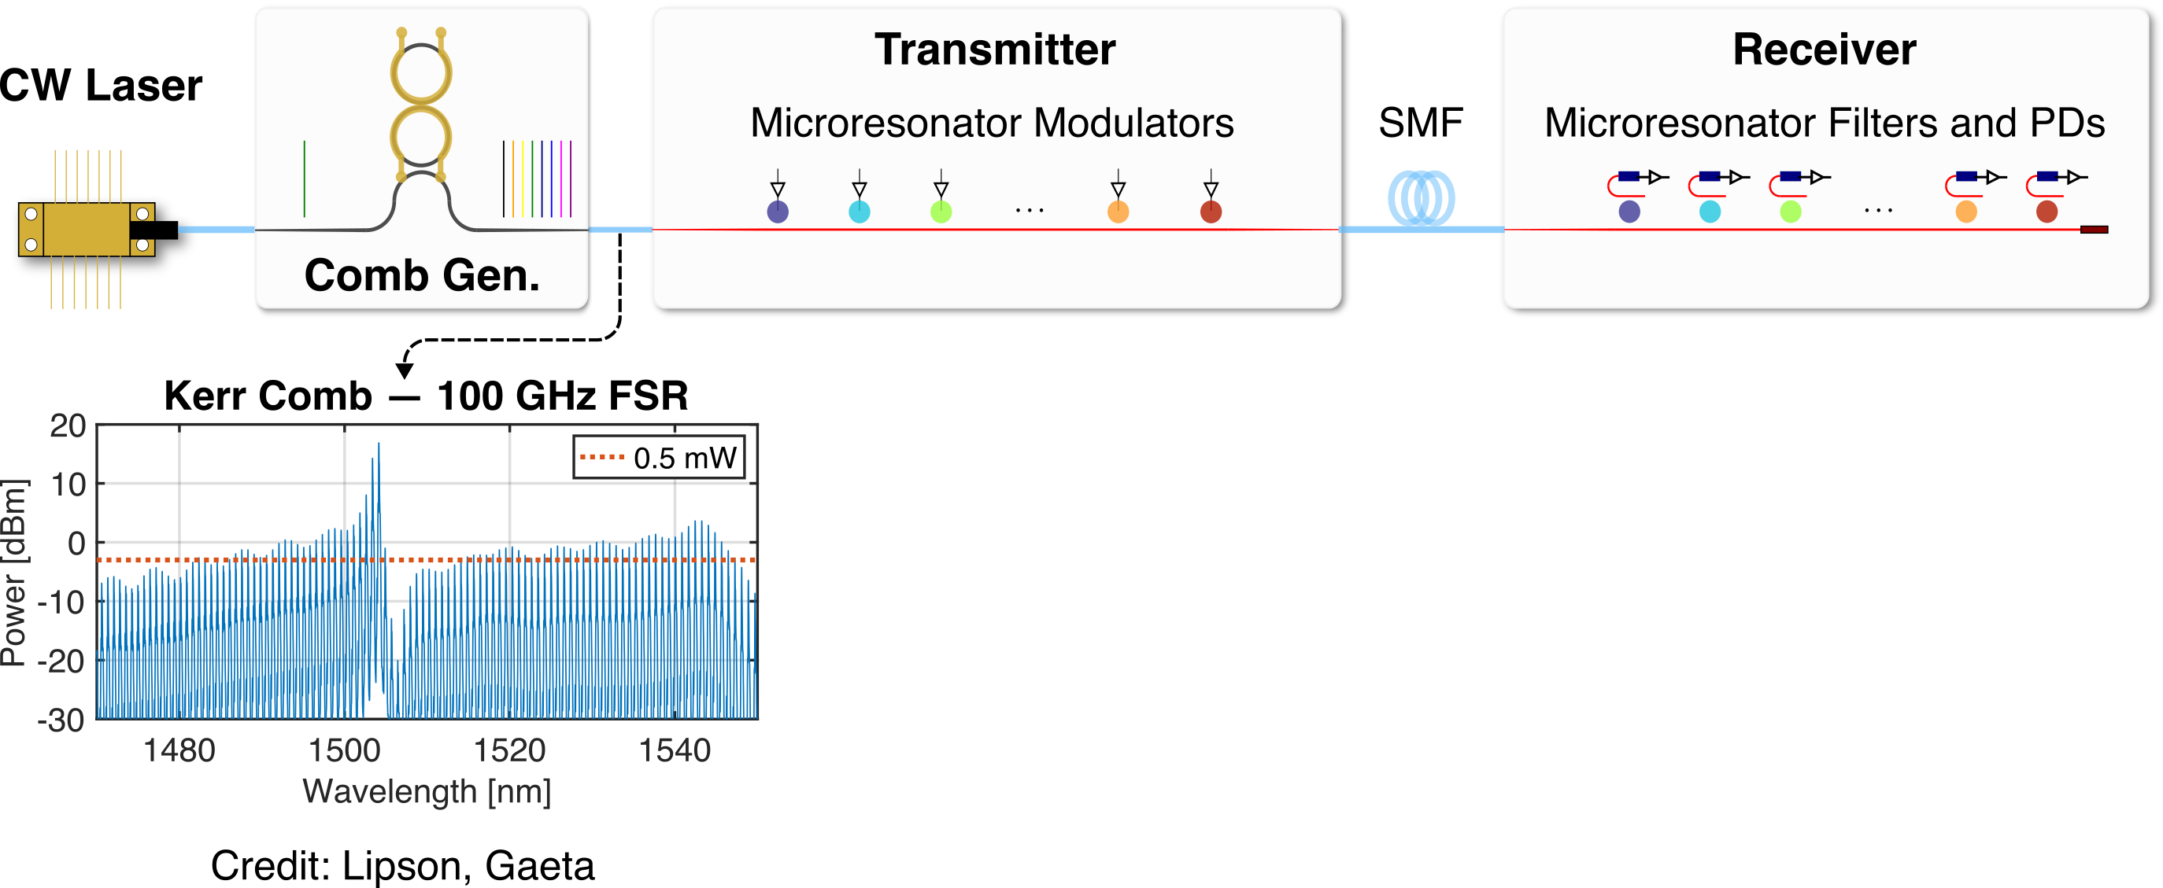
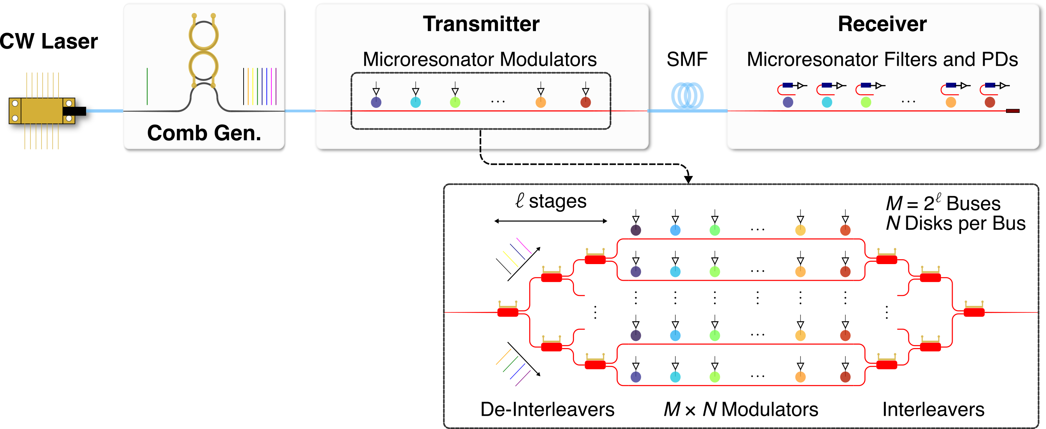
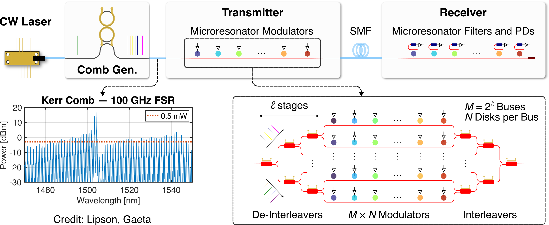
Scalable Link Architecture: Massive Wavelength Parallelism
# of wavelengths per link: from today’s less than 16 to greater than 64
High aggregate bandwidth with moderate data rate per channel

Slide 7
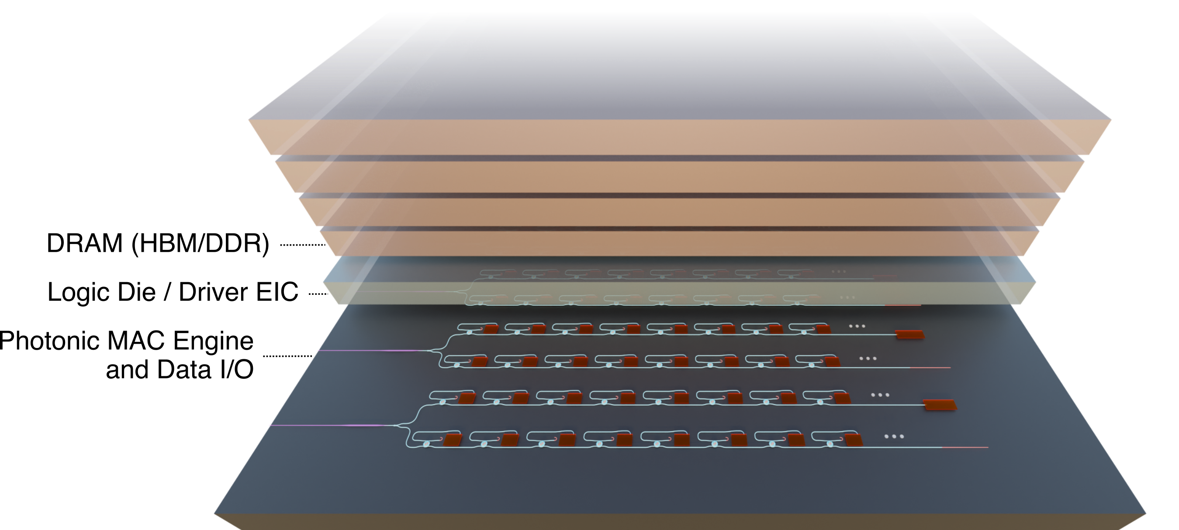
Computing within Data Movement

Slide 8
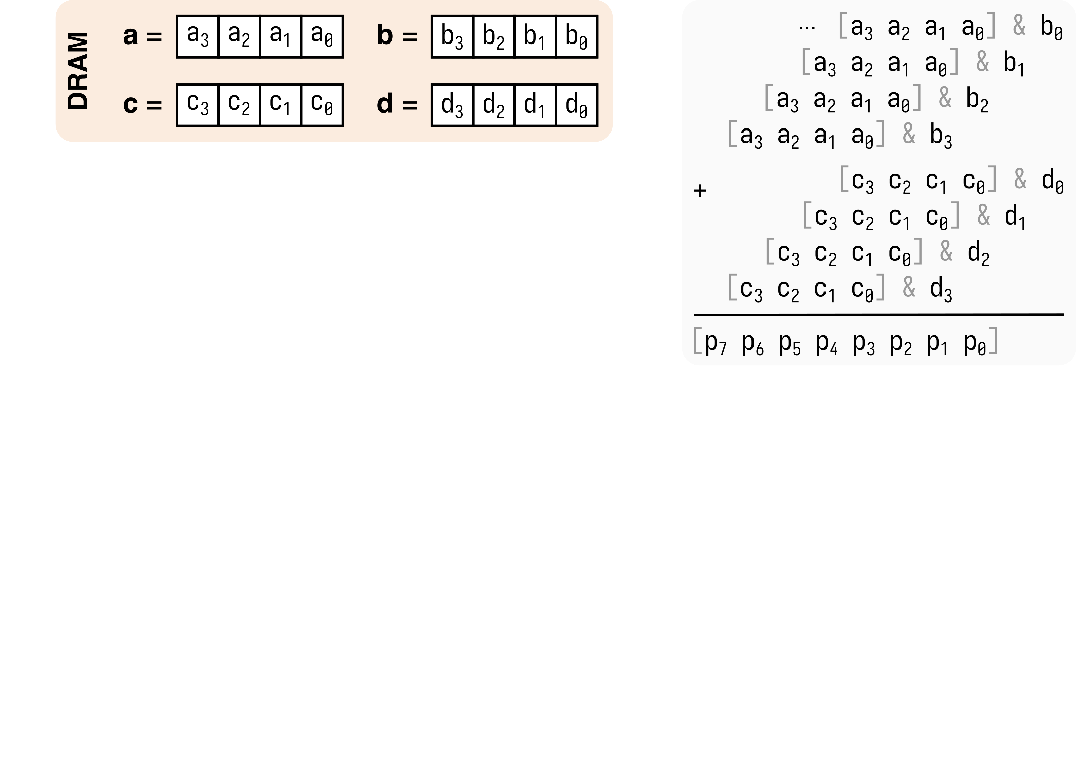
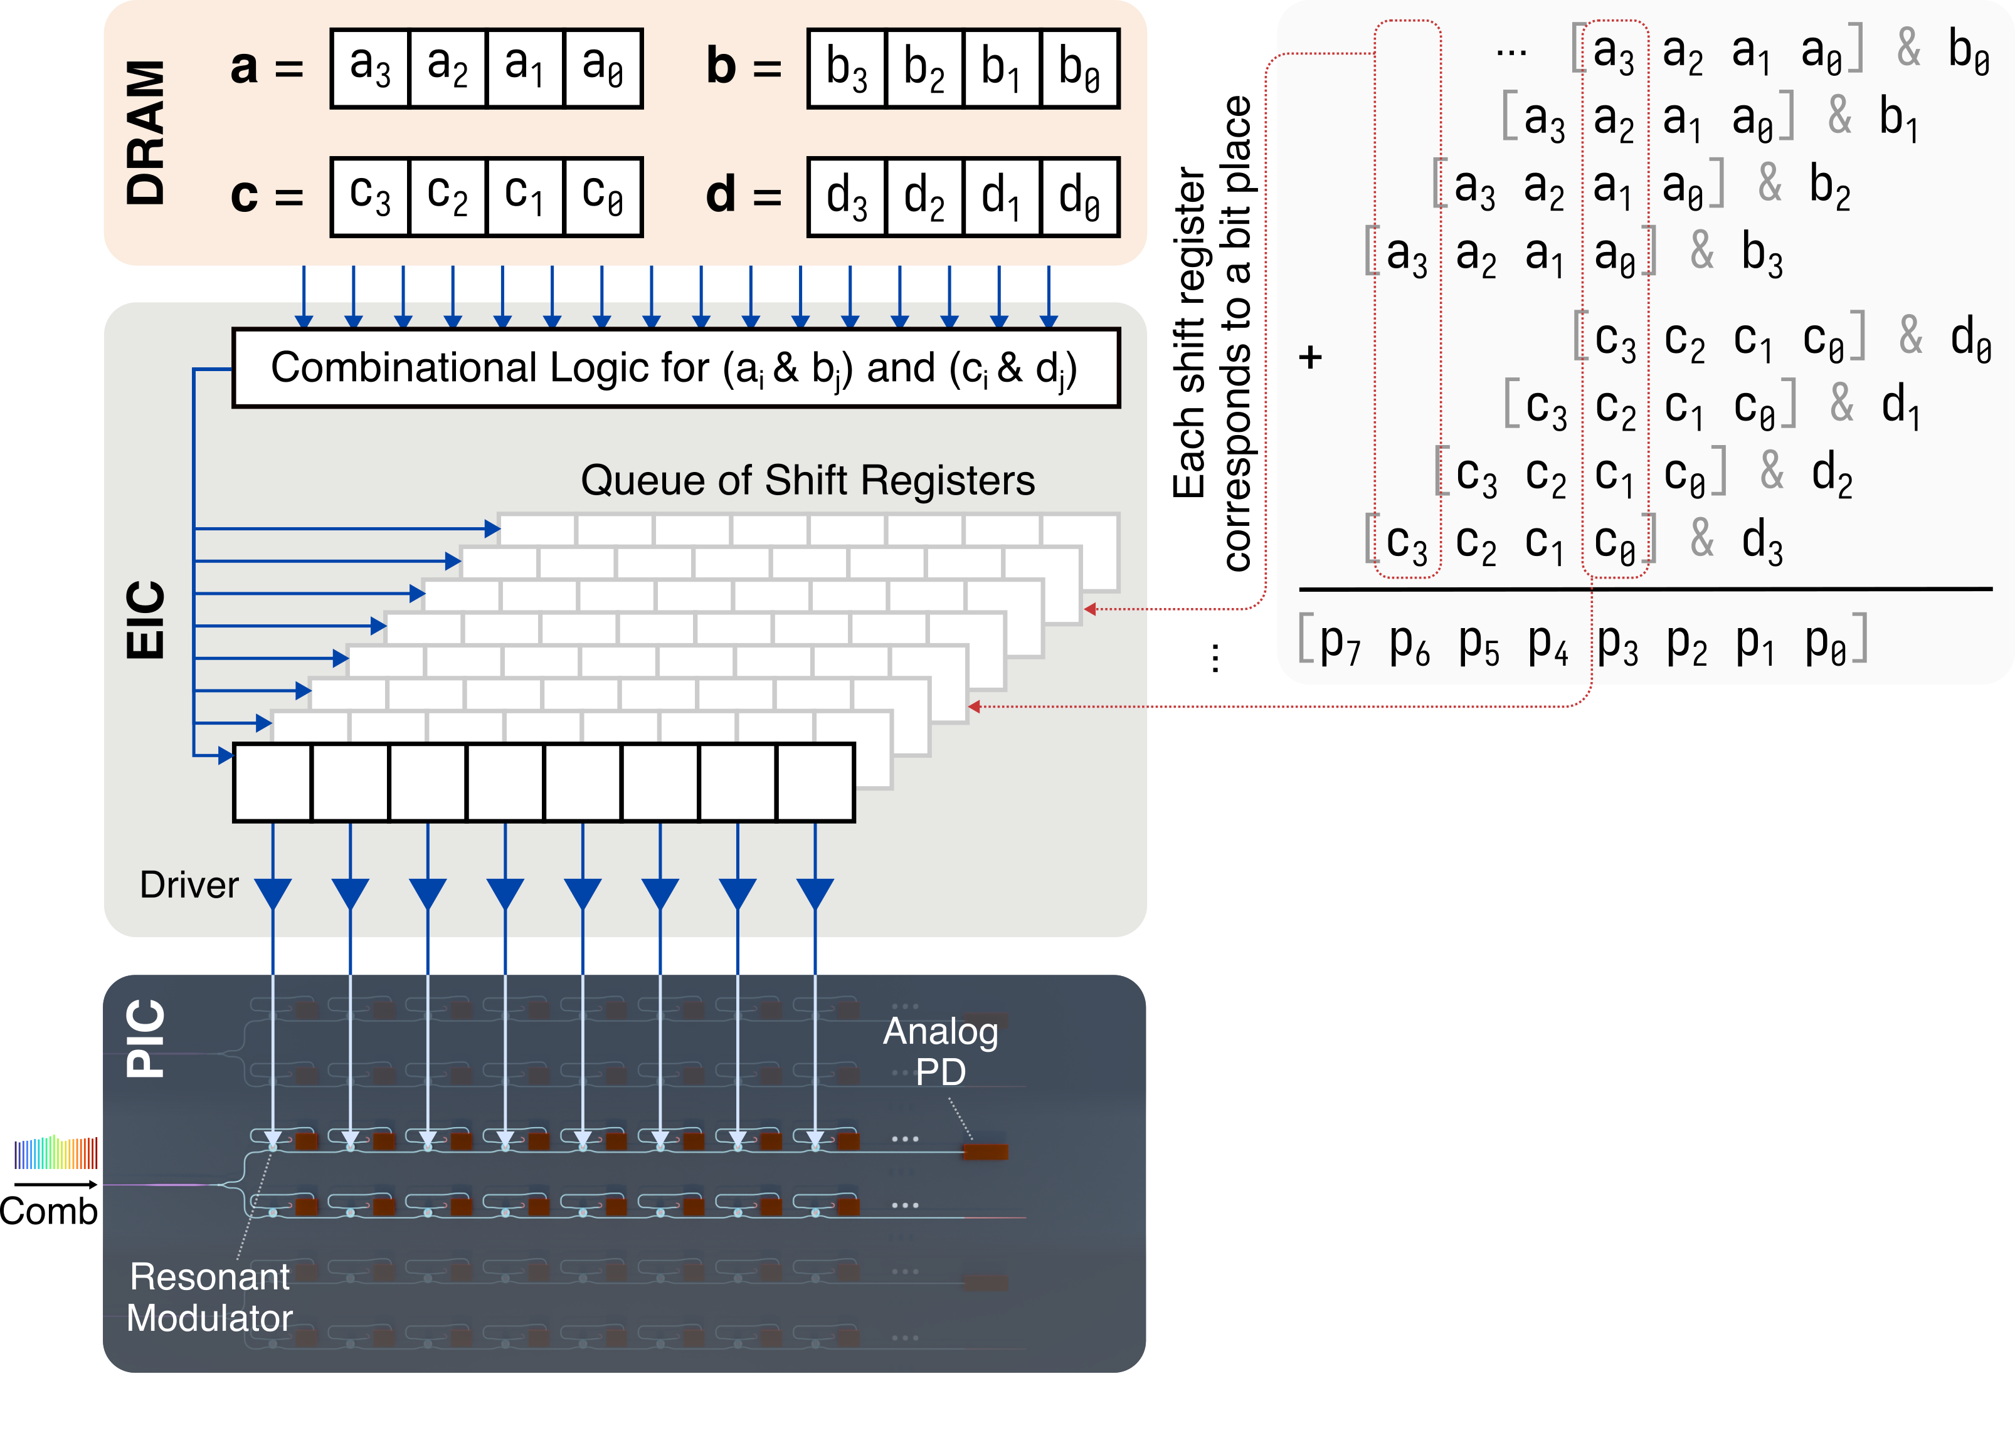
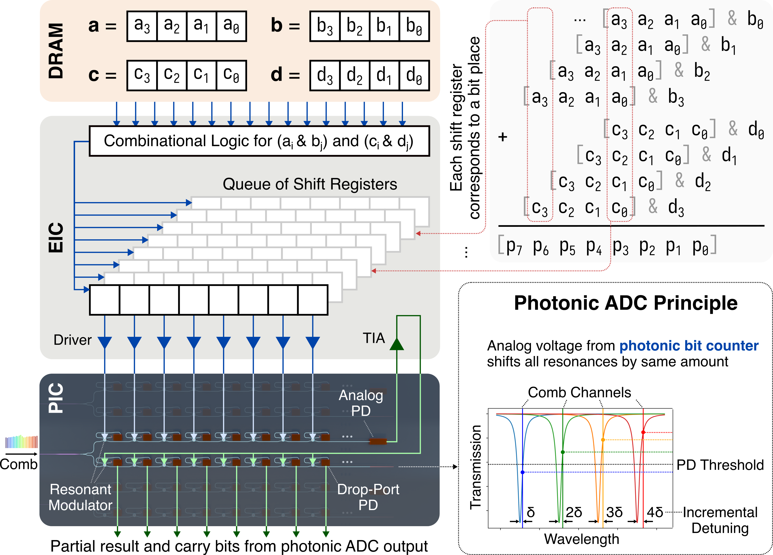
Photonic MAC Operation with Full Digital Precision
Existing Photonic MAC
Computes in analog domain
Extra DAC and ADC steps
Limited precision
My Approach
One wavelength per bit place
Counts # of 1’s instantaneously
Partial results and carry bits from photonic ADC
Retains full digital precision

Slide 9
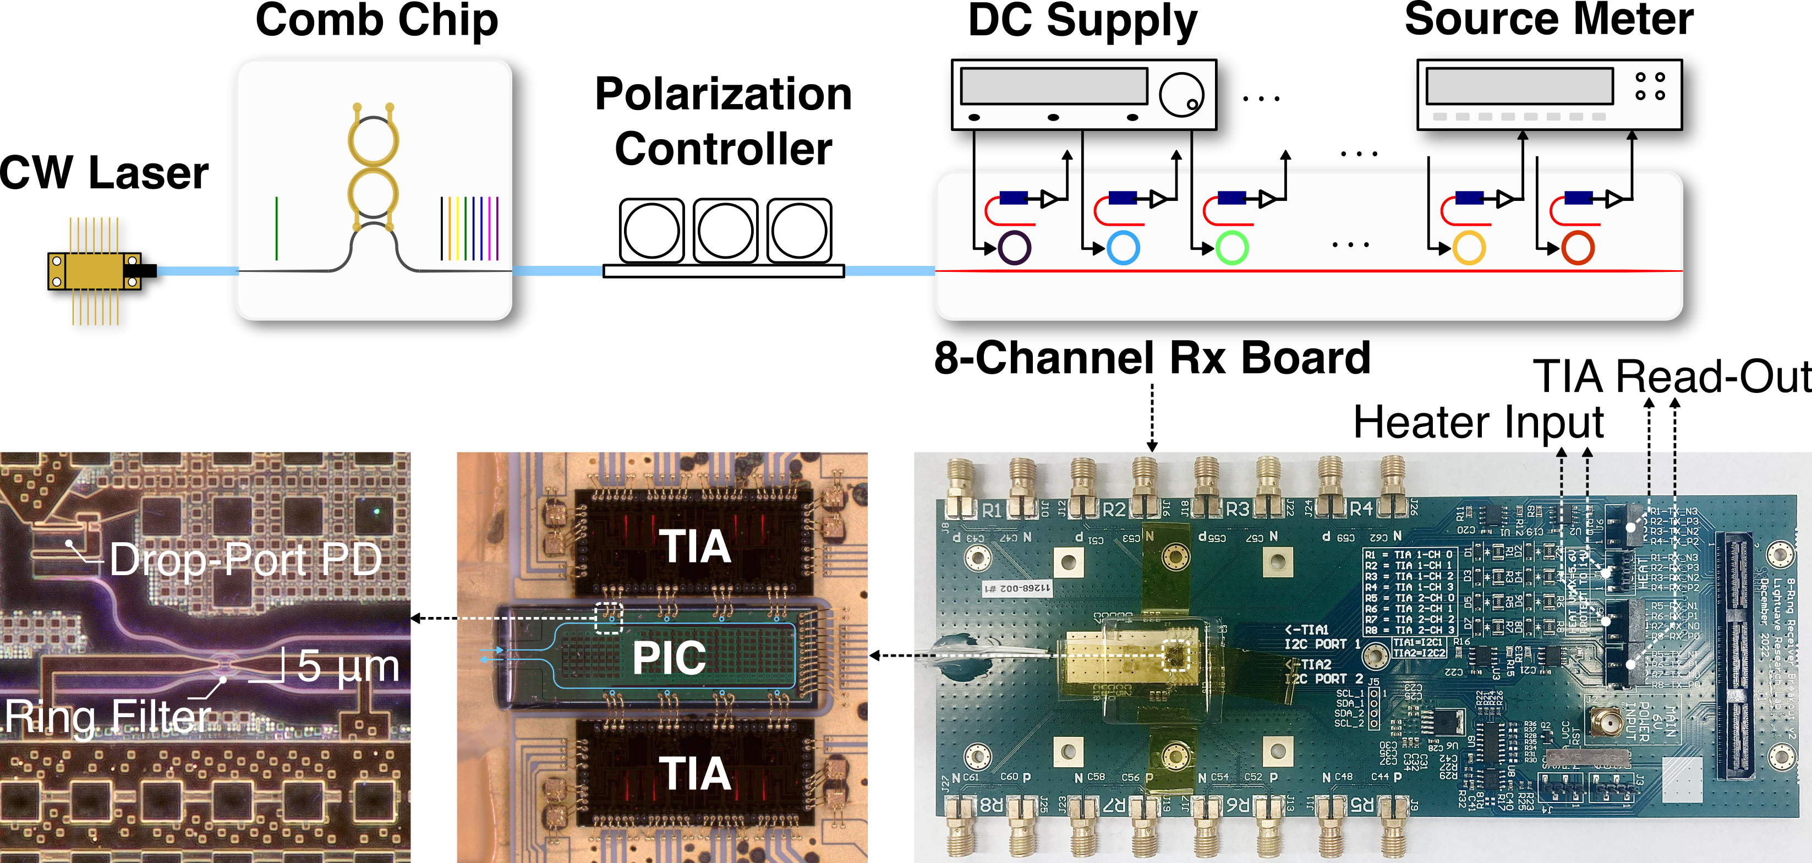
Hardware Validation of Photonic MAC Architecture

Slide 10
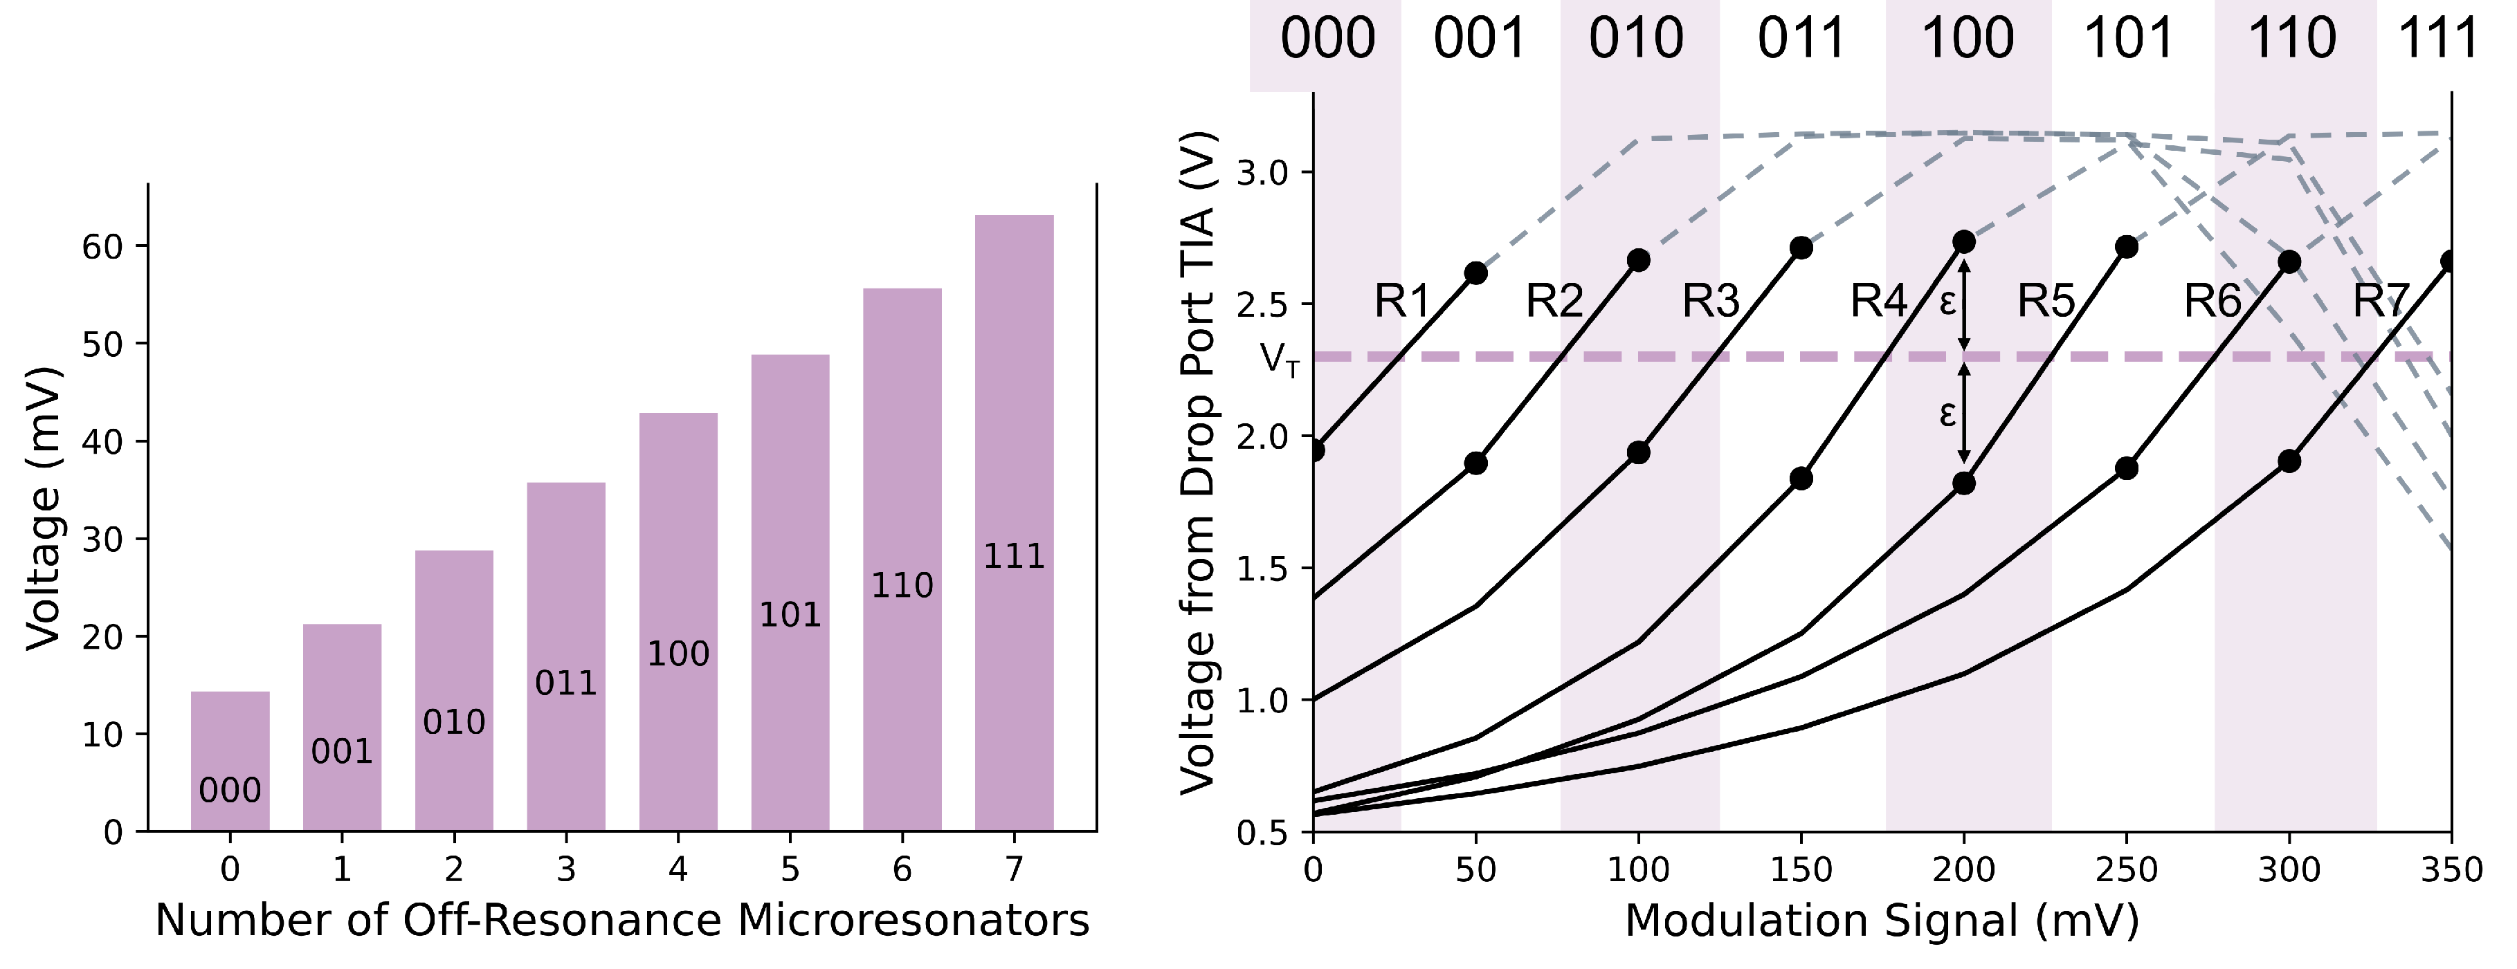
Photonic Bit Counting and ADC
# of 1’s → Voltage
Amplified Voltage → Digital

Slide 11
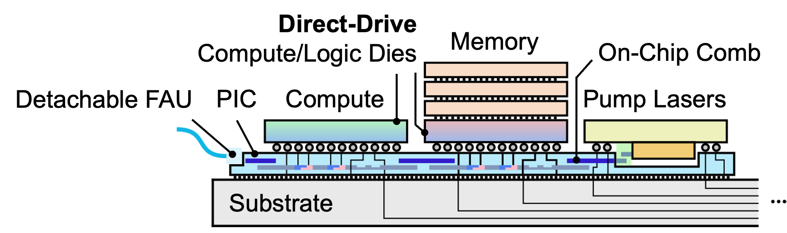
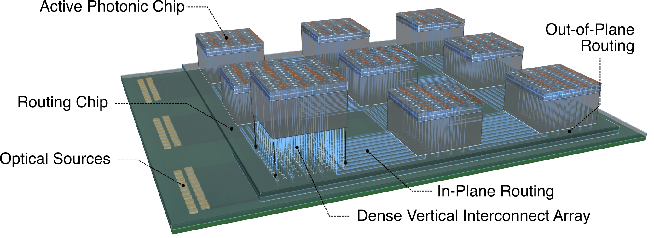
Future Directions
Heterogeneous Integration
Integrated comb source
Direct-drive photonics
3D Photonic Connectivity
Break planar photonics limitations
Wafer- / Panel-scale computing
Network-Application Co-Design
Acceleration and energy saving
Diverse application, e.g., RF
Collaborations
Materials and devices (Frank Fan)
Integrated photonics and RF (Zeinolabedinzadeh)
Heterogeneous integration (K. Chakrabarty)
EPDA, digital twins (Chhabria)

Slide 12
Thank you!

